Slide 1
Evolutionary Algorithms – Applications in real life

Slide 2
Outcomes
Quick recap of last few weeks
Gain a better understanding of phenotype to genotype mappings
Understand fitness functions and their importance
Review some real life examples
A first look at discipline combination (Neural networks and EA's)

Slide 3
Evolving Robby – The problem
Example taken from 'Complexity – A guided tour', Melanie Mitchell
World consists of 100 squares in a 10x10 grid
Robby starts at site 0,0
Cans are randomly distributed across world
Evolve strategy to collect all the cans in the shortest possible route

Slide 4
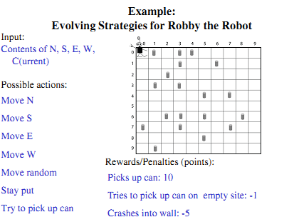
Evolving Robby - Parameters

Slide 5
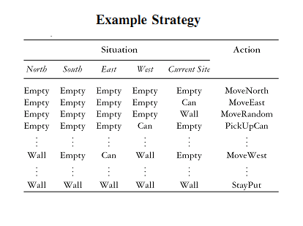
Evolving Robby - Strategy

Slide 6
Evolving Robby – Designing
Robby can at any time be in one of 243 situations
Encode genotype as strings of possible actions
  0 – MoveNorth
  1 – MoveEast
  2 – MoveWest
  3 – MoveSouth
  4 – MoveRnd
  5 – PickUp
  6 – StayPut

Slide 7
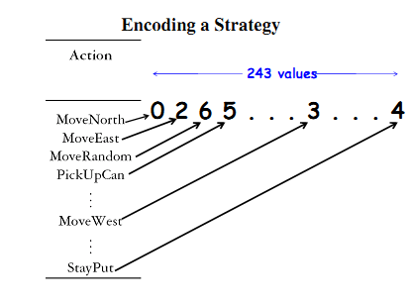
Evolving Robby – Designing (cont)

Slide 8
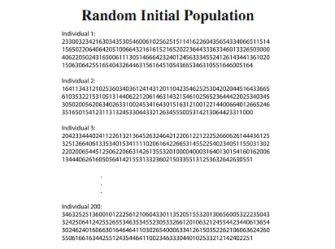
Evolving Robby – Initial population

Slide 9
Evolving Robby – The task
Generate an initial population of 200
Run each candidate through 100 randomly generated search spaces for 200 actions
Calculate fitness for each 100 spaces then derive the average – this is the fitness
Recombine and mutate
Re-run with new population of children
Repeat for 1000 generations

Slide 10
Evolving Robby – A human attempt
If there is a can in the current site, pick it up
Otherwise, if there is a can in one of the adjacent sites, move to that site
Otherwise, choose a random non-wall direction to move in
Repeat for 200 turns
Average fitness – 346 / 500
Average fitness of GA – 486 / 500

Slide 11
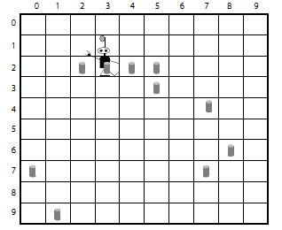
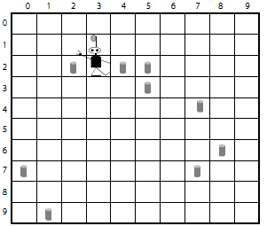
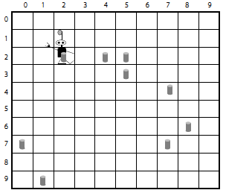
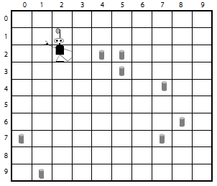
Evolving Robby – A human attempt
a
a
b
c
d

Slide 12
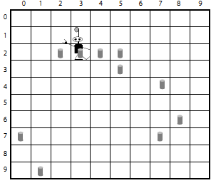
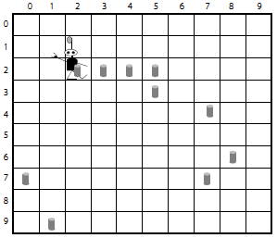
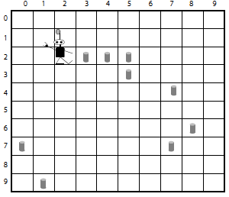

Evolving Robby – An EA attempt(1)
a
a
b
c
d

Slide 13
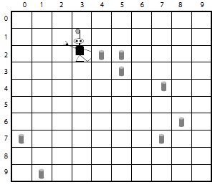
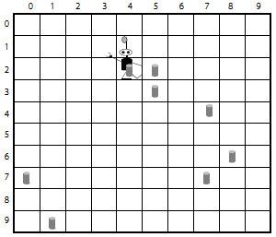
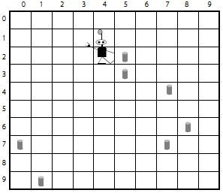
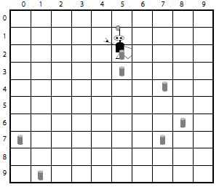
Evolving Robby – An EA attempt (2)
e
f
g
h

Slide 14
Evolving Robby – Another view
See: http://robbie.thattommyhall.com/robbie/display

Slide 15
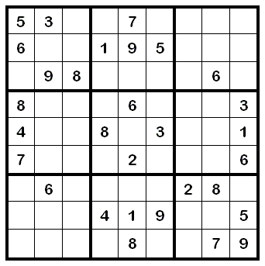
Solving Sudoku – The problem
A logic based game where the solver is required to deduce the position of a number on the grid by assessing the position of the numbers already placed
Many constraints in place
Must factor in any 'givens'
Genotype design needs to
maintain puzzle structure

Slide 16
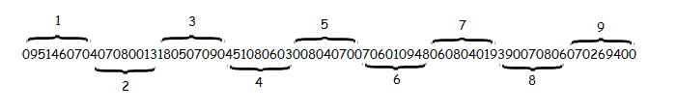
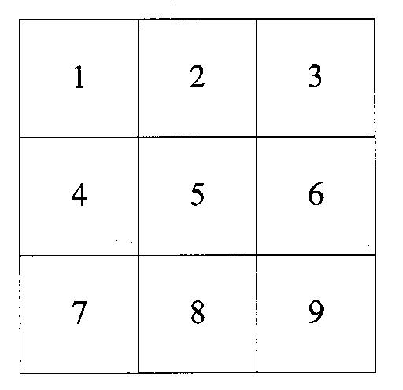
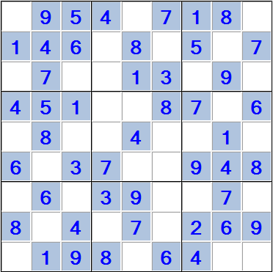
Solving Sudoku – Genotype

Slide 17
Solving Sudoku – Fitness function
Sum of a completed row = 45
Sum of a completed column = 45
Each row and column calculated and deducted from 45
Bonus for number of unique numbers in row/column – subtracted from 9 to give fitness
Both fitness added together
Complete solution has fitness 0 (zero)

Slide 18
Solving Sudoku – Crossover
Blocks (1-9) chosen as random
Number of blocks to crossover selected from choice of 0-3 with 1 most likely
Crossover maintains structure of puzzle and location of 'givens'

Slide 19
Solving Sudoku – Mutation
Initially set to occur in 10% of cases
Mutation takes place on a block
  Checks for 'givens'
  Randomly chooses two values in block not 'given'
  Swaps these two values
Maintains the overall structure of the problem (each block must consist of the numbers 1-9)
Mutation happens once per genotype
Rate of mutation increases as generations increase

Slide 20
Solving Sudoku – Local optimums
Requirement to maintain structure can cause program to get stuck in local optimums
Elitist approach adopted
After set number of generations, disaster occurs
All populations are deleted except for current best performing
New random population generated and elite solution is added to pool

Slide 21
Antenna Design - Problem
From paper “An evolved antenna for deployment on NASA's Space Technology 5 mission”; Lohn, Hornby, Linden
Needs to determine the x-y-z coordinates of the 3-dimensional position of the ends (X1, Y1, Z1, X2, Y2, Z2,… , X7, Y7, Z7) of 7 straight wires
First wire starts at (0,0,0)
Antenna design restraint variable (0.5 here)

Slide 22
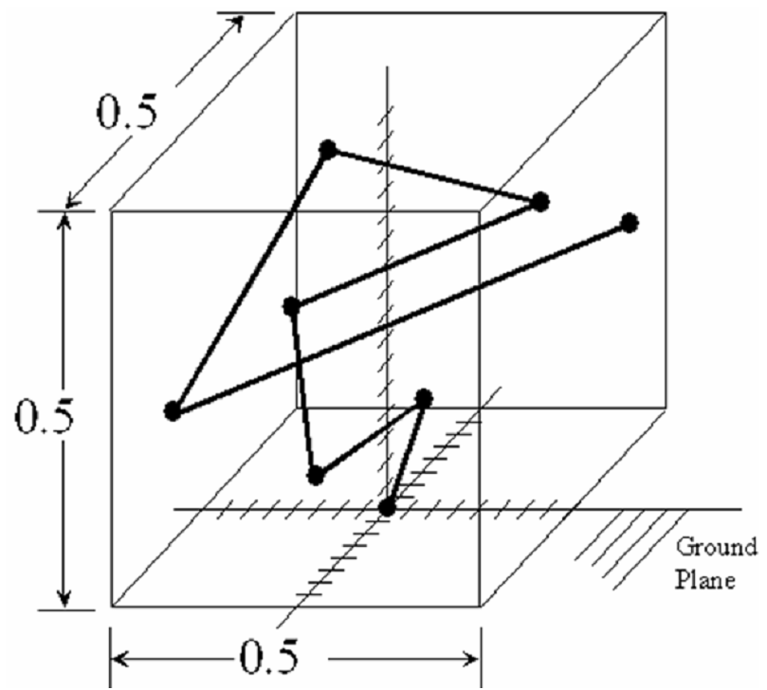
Antenna Design - Example

Slide 23
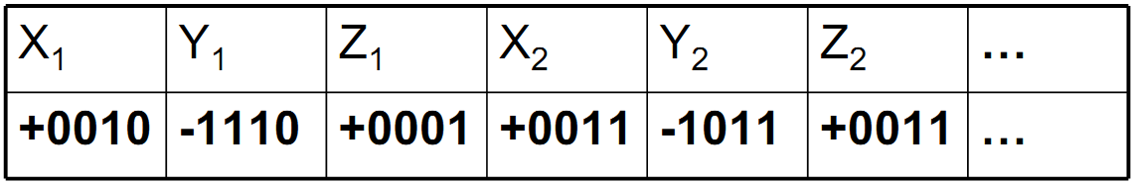
Antenna Design – Genotype
105 bits in genome
XYZ coordinates represented by 5 bits (one as signed bit)

Slide 24
Antenna Design - Fitness
Fitness measured using Numerical Electromagnetic Code (NEC) simulation
  Measures an antennas radiation pattern https://en.wikipedia.org/wiki/Numerical_Electromagnetics_Code
Calculated as the 'sum of the squares of the difference between the average gain and and antennas gain”
Radiation can be considered for angles Θ between -90° and +90° and all azimuth angles Φ from 0° to 180°
The smaller the value, the greater the fitness

Slide 25
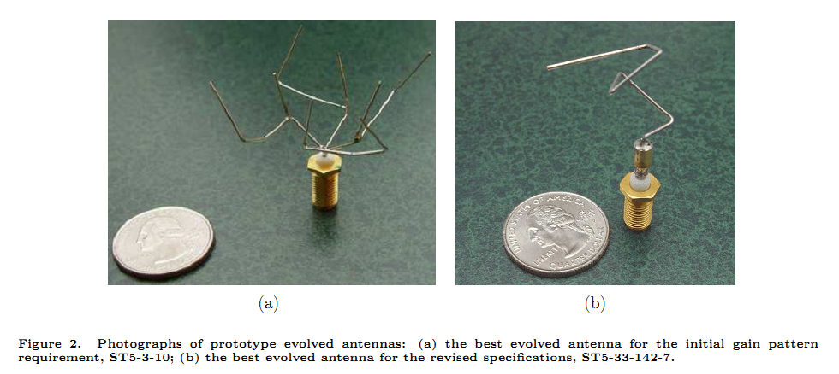
Antenna Design - Solutions

Slide 26
Combinations
Evolutionary computation is often used in combination with other AI/Complexity techniques or applications
  Neural Networks
  Cellular Automata (Game of Life, Wolfram)
  Physics/Game engines (Box2D, Valves Source)
  Non-Linear dynamics (Chaos theory, fractals)

Slide 27
Combinations – Neural Cars
Full code available to download
Shows example of using GA to evolve Neural Network weights
Try and understand how it works before coding your own projects

